Slide 1
Disaster Recovery With IBM Cloud Virtual Servers
Arockia Antony Luvin A

Slide 2
Agenda
Introduction
Primary goals
Analysis
Timeline
Summary

Slide 3

Introduction
Creating a disaster recovery project is essential to ensure that your organization
can recover from unexpected events, such as natural disasters, data
breaches, or other crises. Here's a step-by-step guide on how to make
a disaster recovery project:
1.Assessment and Risk Analysis
2. Define Objectives
3.Create a Team
4.Asset Inventory
5.Risk Mitigation Strategies

Slide 4
Primary goals
Annual revenue growth

Slide 5
Problem Definition and Thinking
The project involves creating a disaster recovery plan using IBM Cloud Virtual Servers. The objective is to safeguard business operations by developing a plan that ensures continuity for an on-premises virtual machine in unforeseen events. This plan will include setting up backup strategies, configuring replication, testing the recovery process, and guaranteeing minimal downtime. The project encompasses defining the disaster recovery strategy implementing backup and replication, validating recovery procedures, and ensuring business continuity.

Slide 6
Safeguard business operations with IBM Cloud Virtual Servers. Create a disaster recovery plan for an on-premises virtual machine, ensuring continuity in unforeseen events. Test and validate the recovery process to guarantee minimal downtime. Become the guardian of business continuity, securing the future of your organization!
Problem Statement:
“
”
Richard Branson

Slide 7
Plan for product launch
Regularly test your disaster recovery plan to ensure it works effectively. This may involve simulations or tabletop exercises.
Analysis
Identify potential risks and threats that could disrupt your business operations
Define Objectives
Establish clear objectives for your disaster recovery project
Risk Mitigation Strategies
Develop strategies to mitigate the identified risks, such as backup and redundancy
Create a detailed plan that outlines the steps to be taken in the event of a disaster.
Testing and Training
Disaster Recovery Plan
Documentation and Reporting:
Maintain thorough documentation of your disaster recovery plan, tests, and incidents
Testing and Maintenance:
Regularly test and maintain your disaster recovery plan to ensure its effectiveness and adapt it as your organization evolves.
1
2
3
4
5
6
7

Slide 8
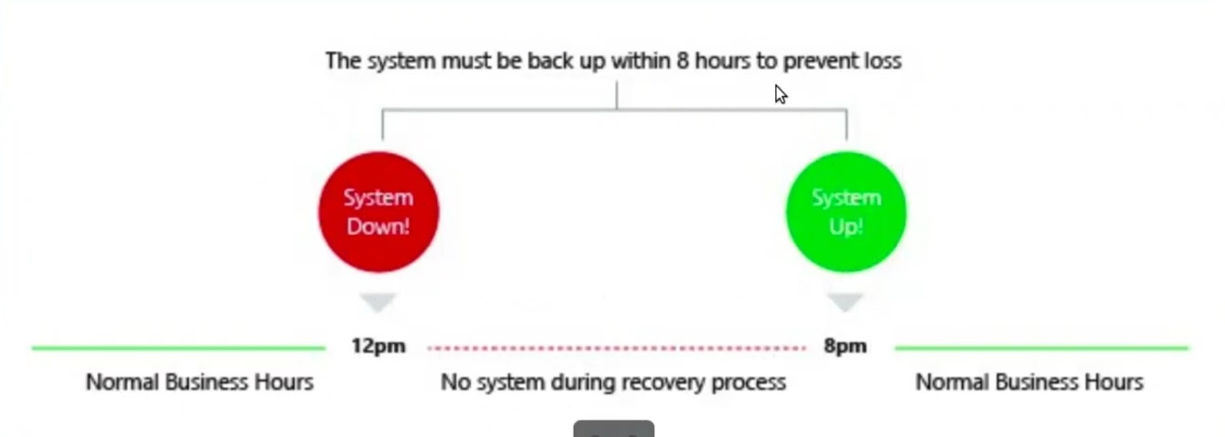
Timeline (RTO)

Slide 9
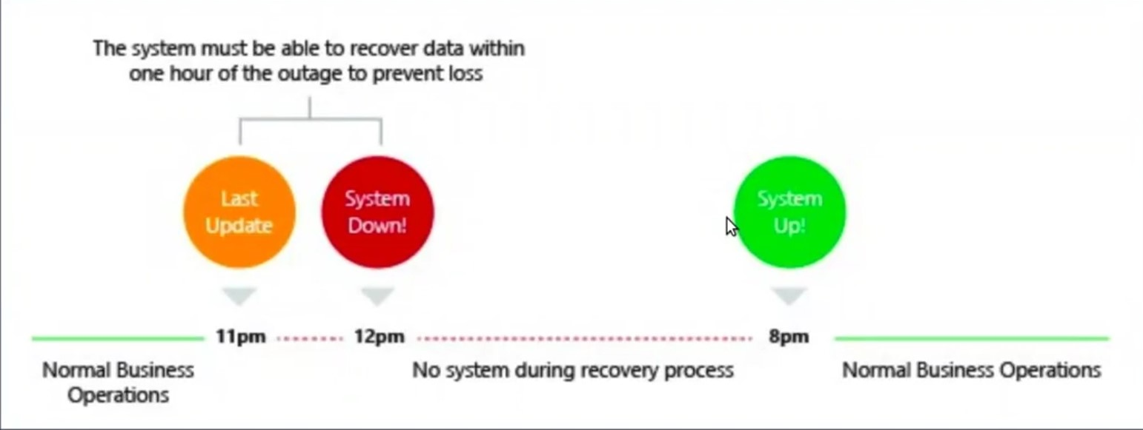
Timeline (RPO)

Slide 10
Recruitment:
Back-up And Recovery
Pilot Light
Worm Standby
Hot Standby
This method involves regularly backing up critical data and systems and restoring them in case of a disaster. Example: Backing up financial data to an offsite server and restoring it if the main data center is destroyed.
Example: Maintaining essential infrastructure components in a powered-off or low-resource state and quickly scaling them up when needed. For instance, keeping minimal server instances ready to run services in the cloud.
Example: Having redundant servers running, but not processing live data. In the event of a disaster, data can be quickly migrated to these servers, minimizing downtime
Example: Running a redundant, fully operational data center in real-time alongside the primary data center. In case of a failure, traffic is instantly redirected to the secondary data center with no noticeable disruption.

Slide 11
Choosing The Above server Recovery
Replication Setup:
Implement replication of data and virtual machine images to IBM Cloud Virtual Servers to ensure up-to-date copies.
Backup Configuration
Configure regular backups of the on-premises virtual machine to capture critical data and configurations.
Business Continuity:
Ensure that the disaster recovery plan aligns with the organization's overall business continuity strategy

Slide 12
Summary
Invention of cloud IBM disaster recovery is dependent's versus environment.so the recovery system applied versus types they will depend cost and important of the source.
Then the project is assigned different environment.so that assistant project way to createing a invention.

Slide 13



Thank you
A.Arockia Antony Luvin​
a.luvin20@gmail.com
8925356605

